Slide 1
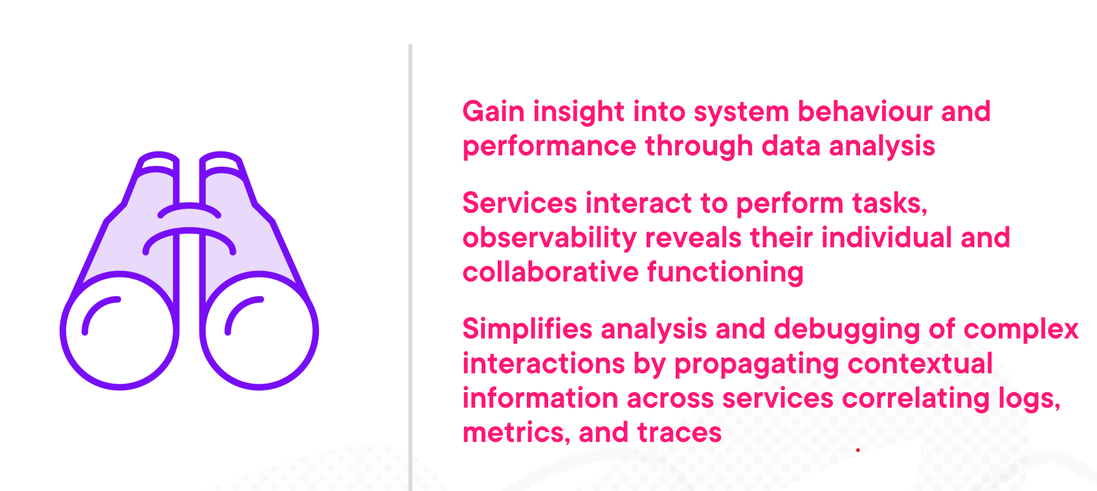
Observability -overview

Slide 2
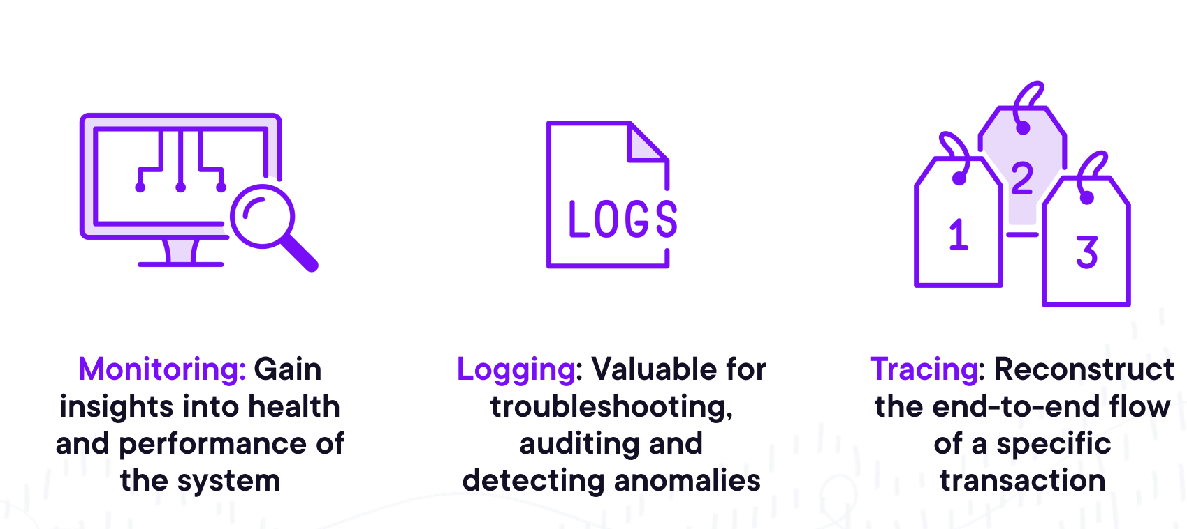
Observability - Pillars

Slide 3
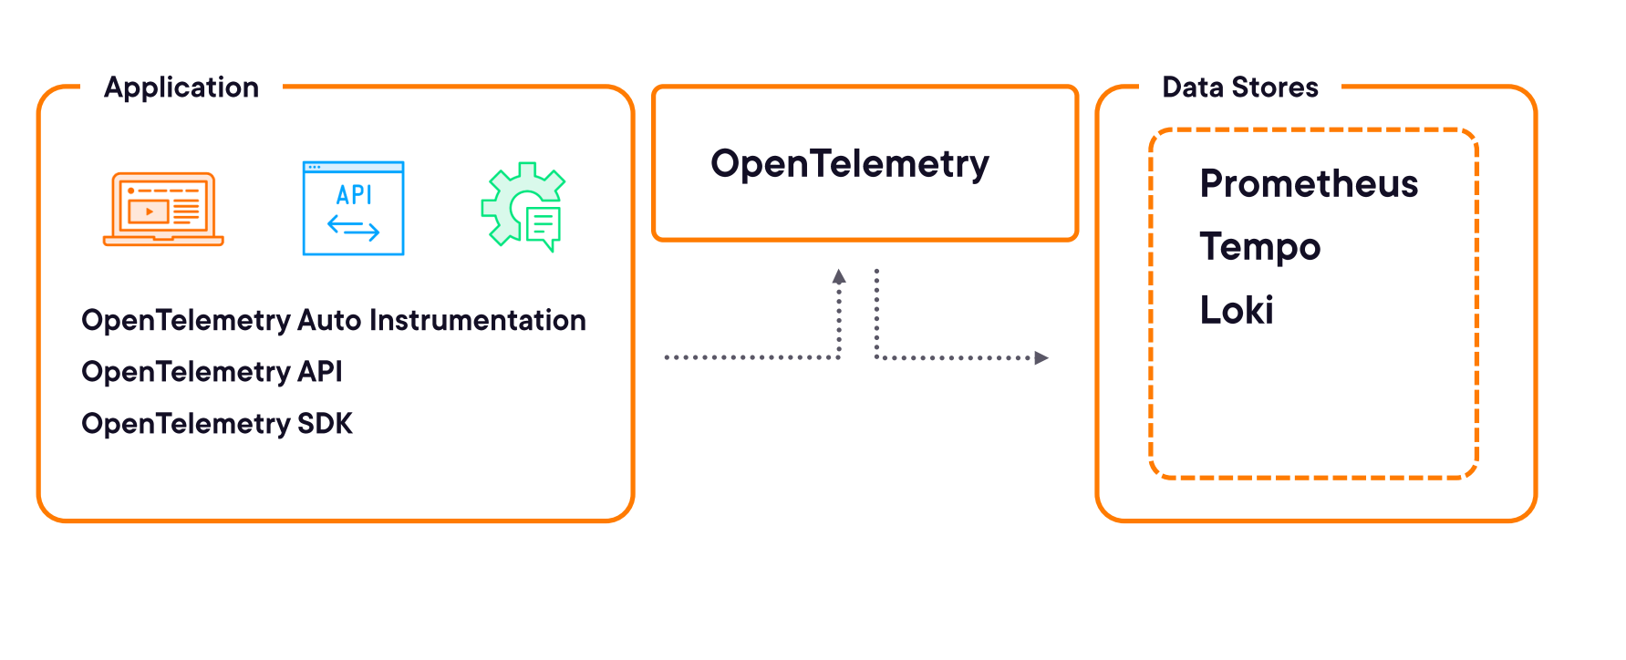
Observability - Opentelemetry

Slide 4
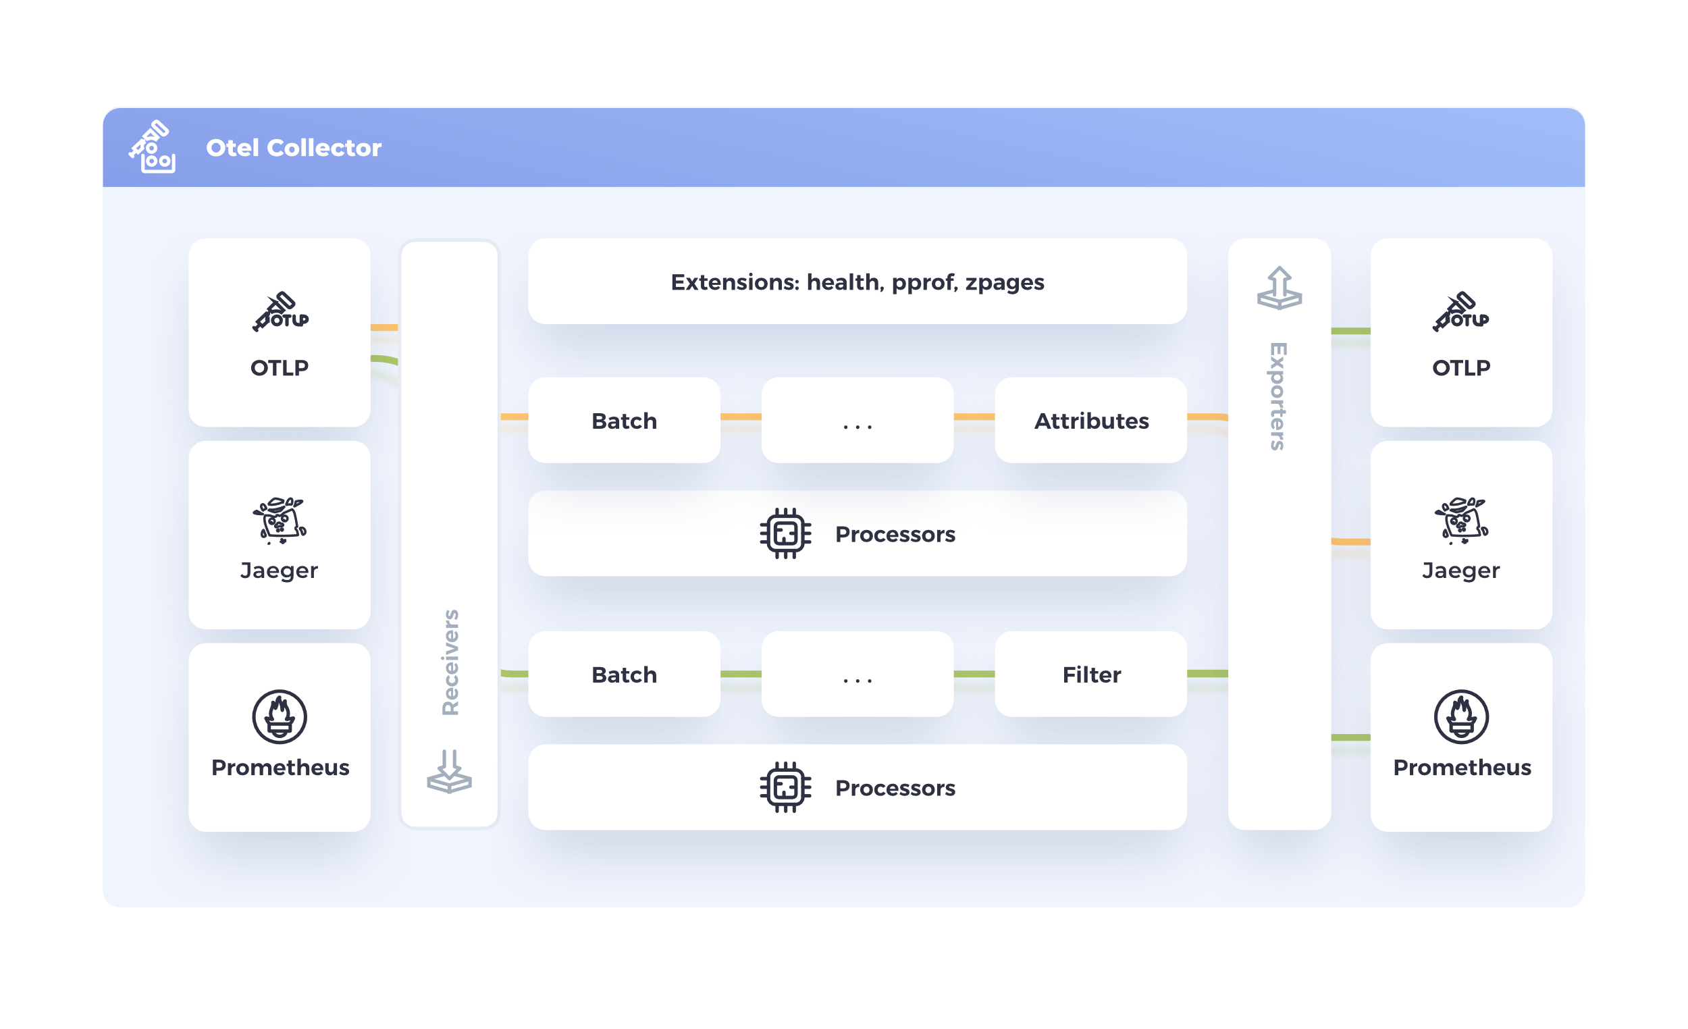
Opentelemetry - architecture

Slide 5
Observability - Example

Slide 6
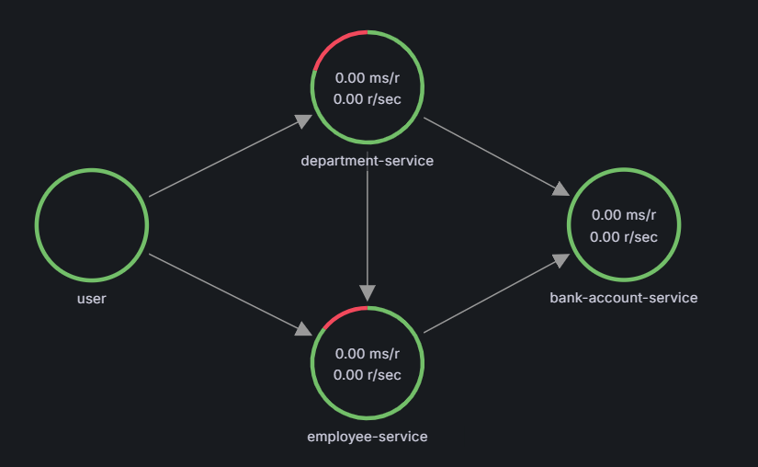
Demo

Slide 7
Observability – Dive deep
Opentelementry SDK
https://app.pluralsight.com/library/courses/observability-technologies-implementation/table-of-contents
https://app.pluralsight.com/library/courses/opentelemetry-grafana-observability/table-of-contents
https://opentelemetry.io/docs/languages/java/
Micrometer instrumentation
https://micrometer.io/

